Slide 1

Solving Real-World Problem Using Machine Learning in Python
GrowIT Novi Sad 2018

Slide 2

Nikola Živković
Team Lead at Vega IT Sourcing
www.rubikscode.net
@NMZivkovic

Slide 3



Courses
Notes:
Mandatory Slide]
This talks about the main steps that are taken to reach the aim of the section. This is basically the highlight of each video that is a part of this section in a list form so that the viewers know what they are getting into.
[

Slide 4

Machine Learning
Notes:
Mandatory Slide]
This talks about the main steps that are taken to reach the aim of the section. This is basically the highlight of each video that is a part of this section in a list form so that the viewers know what they are getting into.
[

Slide 5
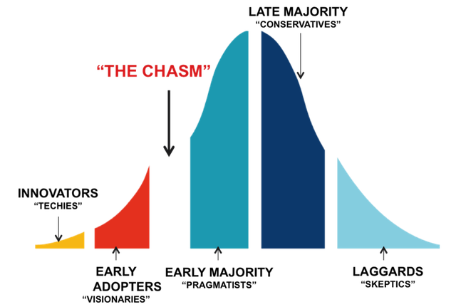
Crossing the Chasm
Notes:
Mandatory Slide]
This talks about the main steps that are taken to reach the aim of the section. This is basically the highlight of each video that is a part of this section in a list form so that the viewers know what they are getting into.
[

Slide 6
Data
Until 2005 – 130 Exabytes
2010 – 1200 Exabytes
2015 – 7900 Exabytes
2020 – 40900 Exabytes
2025 – 193 Zetabytes
Notes:
Mandatory Slide]
This talks about the main steps that are taken to reach the aim of the section. This is basically the highlight of each video that is a part of this section in a list form so that the viewers know what they are getting into.
[

Slide 7
Origin
1763 – Bayes Theorem
1913 – Markov’s Chains
1950 – Turing’s Learning Machine
1957 – Frank Rosenbllat’s Perceptron
Notes:
Mandatory Slide]
This talks about the main steps that are taken to reach the aim of the section. This is basically the highlight of each video that is a part of this section in a list form so that the viewers know what they are getting into.
[

Slide 8
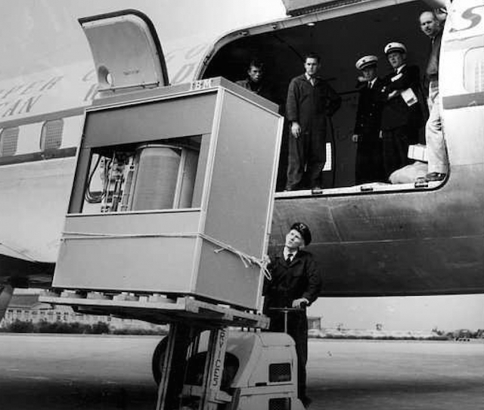
Notes:
Mandatory Slide]
This talks about the main steps that are taken to reach the aim of the section. This is basically the highlight of each video that is a part of this section in a list form so that the viewers know what they are getting into.
[

Slide 9
Machine Learning
Branch of computer science which uses statistical techniques to give computer systems the ability to "learn" (e.g., progressively improve performance on a specific task) from data, without being explicitly programmed.
Notes:
Mandatory Slide]
This talks about the main steps that are taken to reach the aim of the section. This is basically the highlight of each video that is a part of this section in a list form so that the viewers know what they are getting into.
[

Slide 10
Types of Learning
Suppervised Learning
Unsupeprvised Learning
Reinforced Learning
Notes:
Mandatory Slide]
This talks about the main steps that are taken to reach the aim of the section. This is basically the highlight of each video that is a part of this section in a list form so that the viewers know what they are getting into.
[

Slide 11
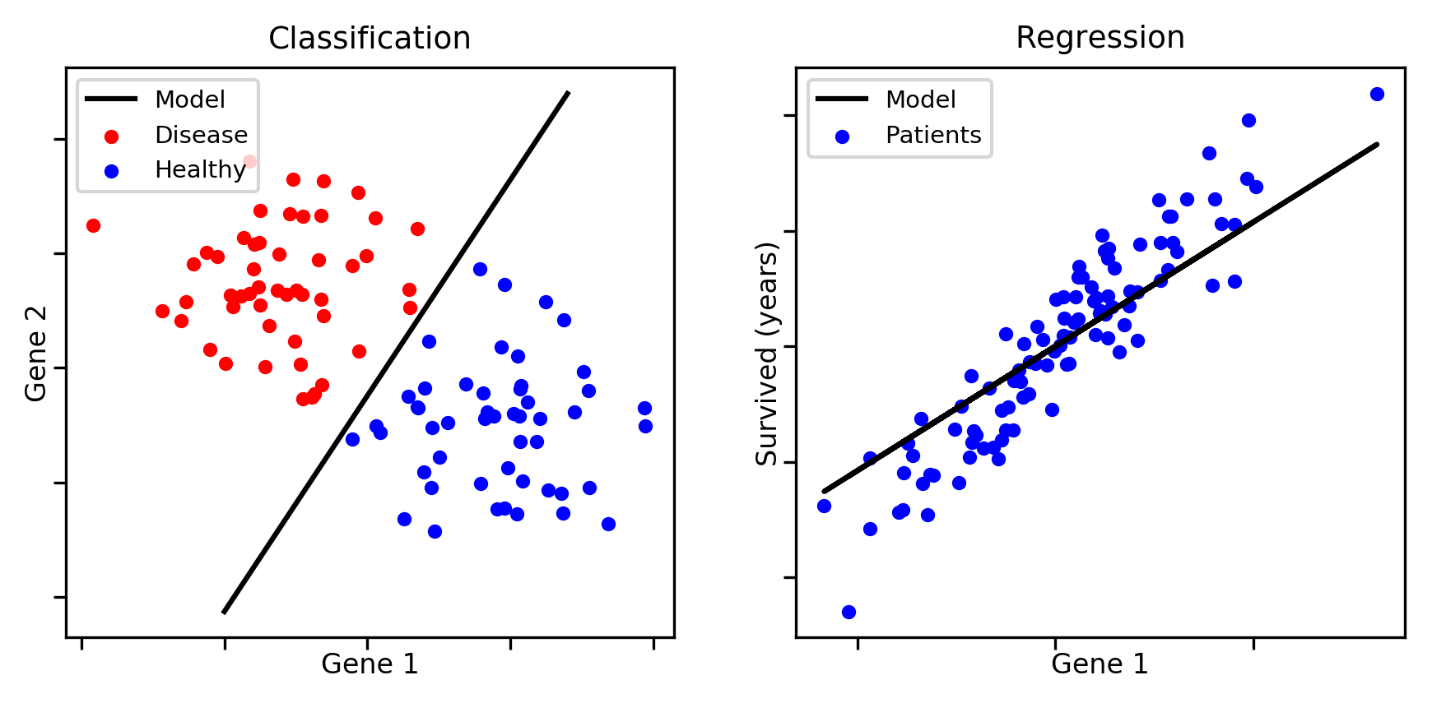
Classification & Regression
Notes:
Mandatory Slide]
This talks about the main steps that are taken to reach the aim of the section. This is basically the highlight of each video that is a part of this section in a list form so that the viewers know what they are getting into.
[

Slide 12
Steps in Building Machine Learning Model
Data Analysis
Applying Proper Algoryhtm
Evaluation
Notes:
[Mandatory Slide]
Before the start of the video, we’d like to highlight what are important topics or pointers that we’d be covering in this video. This slide would immediately follow the intro/name slide. This would just be say 2-3 points for the viewers to know what they are getting into.

Slide 13
Data Analysis
Univariate Analysis
Missing Data Treatment
Outlier Detection
Correlation (Bivariate) Analysis
Notes:
[Mandatory Slide]
Before the start of the video, we’d like to highlight what are important topics or pointers that we’d be covering in this video. This slide would immediately follow the intro/name slide. This would just be say 2-3 points for the viewers to know what they are getting into.

Slide 14
Algorythms That are Applied
Logistic Regression
Decision Trees
Random Forest
Notes:
[Mandatory Slide]
Before the start of the video, we’d like to highlight what are important topics or pointers that we’d be covering in this video. This slide would immediately follow the intro/name slide. This would just be say 2-3 points for the viewers to know what they are getting into.

Slide 15
Algorithms used for evaluation
RMSLE – Root Mean Squared Logarithmic Error
RMSLE = log(pedicted+1)−log(actual+1)
Notes:
[Mandatory Slide]
Before the start of the video, we’d like to highlight what are important topics or pointers that we’d be covering in this video. This slide would immediately follow the intro/name slide. This would just be say 2-3 points for the viewers to know what they are getting into.

Slide 16
Bike Sharing Demand
Bike sharing systems are a means of renting bicycles where the process of obtaining membership, rental, and bike return is automated via a network of kiosk locations throughout a city.
Using these systems, people are able rent a bike from a one location and return it to a different place on an as-needed basis. Currently, there are over 500 bike-sharing programs around the world.
The data generated by these systems makes them attractive for researchers because the duration of travel, departure location, arrival location, and time elapsed is explicitly recorded.
Notes:
Mandatory Slide]
This talks about the main steps that are taken to reach the aim of the section. This is basically the highlight of each video that is a part of this section in a list form so that the viewers know what they are getting into.
[

Slide 17
Bike Sharing Demand Data
Kaggle and UCI are hosting this competition for the machine learning community to use for fun and practice.
This dataset was provided by Hadi Fanaee Tork using data from Capital Bikeshare.
Notes:
[Mandatory Slide]
Before the start of the video, we’d like to highlight what are important topics or pointers that we’d be covering in this video. This slide would immediately follow the intro/name slide. This would just be say 2-3 points for the viewers to know what they are getting into.

Slide 18
Bike Sharing Demand Data Set
instant | dteday | season | yr | mnth | hr | holiday | weekday | workingday | weathersit | temp | atemp | hum | windspeed | casual | registered | cnt
1 | ######## | 1 | 0 | 1 | 0 | 0 | 6 | 0 | 1 | 0.24 | 0.2879 | 0.81 | 0 | 3 | 13 | 16
2 | ######## | 1 | 0 | 1 | 1 | 0 | 6 | 0 | 1 | 0.22 | 0.2727 | 0.8 | 0 | 8 | 32 | 40
3 | ######## | 1 | 0 | 1 | 2 | 0 | 6 | 0 | 1 | 0.22 | 0.2727 | 0.8 | 0 | 5 | 27 | 32
4 | ######## | 1 | 0 | 1 | 3 | 0 | 6 | 0 | 1 | 0.24 | 0.2879 | 0.75 | 0 | 3 | 10 | 13
5 | ######## | 1 | 0 | 1 | 4 | 0 | 6 | 0 | 1 | 0.24 | 0.2879 | 0.75 | 0 | 0 | 1 | 1
6 | ######## | 1 | 0 | 1 | 5 | 0 | 6 | 0 | 2 | 0.24 | 0.2576 | 0.75 | 0.0896 | 0 | 1 | 1
7 | ######## | 1 | 0 | 1 | 6 | 0 | 6 | 0 | 1 | 0.22 | 0.2727 | 0.8 | 0 | 2 | 0 | 2
8 | ######## | 1 | 0 | 1 | 7 | 0 | 6 | 0 | 1 | 0.2 | 0.2576 | 0.86 | 0 | 1 | 2 | 3
9 | ######## | 1 | 0 | 1 | 8 | 0 | 6 | 0 | 1 | 0.24 | 0.2879 | 0.75 | 0 | 1 | 7 | 8
10 | ######## | 1 | 0 | 1 | 9 | 0 | 6 | 0 | 1 | 0.32 | 0.3485 | 0.76 | 0 | 8 | 6 | 14
11 | ######## | 1 | 0 | 1 | 10 | 0 | 6 | 0 | 1 | 0.38 | 0.3939 | 0.76 | 0.2537 | 12 | 24 | 36
12 | ######## | 1 | 0 | 1 | 11 | 0 | 6 | 0 | 1 | 0.36 | 0.3333 | 0.81 | 0.2836 | 26 | 30 | 56
13 | ######## | 1 | 0 | 1 | 12 | 0 | 6 | 0 | 1 | 0.42 | 0.4242 | 0.77 | 0.2836 | 29 | 55 | 84
14 | ######## | 1 | 0 | 1 | 13 | 0 | 6 | 0 | 2 | 0.46 | 0.4545 | 0.72 | 0.2985 | 47 | 47 | 94
15 | ######## | 1 | 0 | 1 | 14 | 0 | 6 | 0 | 2 | 0.46 | 0.4545 | 0.72 | 0.2836 | 35 | 71 | 106
16 | ######## | 1 | 0 | 1 | 15 | 0 | 6 | 0 | 2 | 0.44 | 0.4394 | 0.77 | 0.2985 | 40 | 70 | 110
17 | ######## | 1 | 0 | 1 | 16 | 0 | 6 | 0 | 2 | 0.42 | 0.4242 | 0.82 | 0.2985 | 41 | 52 | 93
Notes:
[Mandatory Slide]
Before the start of the video, we’d like to highlight what are important topics or pointers that we’d be covering in this video. This slide would immediately follow the intro/name slide. This would just be say 2-3 points for the viewers to know what they are getting into.

Slide 19
Bike Sharing Demand Data Set
15 independent variables and one dependant one
Consists of two files: Hours.csv & Day.csv
Notes:
[Mandatory Slide]
Before the start of the video, we’d like to highlight what are important topics or pointers that we’d be covering in this video. This slide would immediately follow the intro/name slide. This would just be say 2-3 points for the viewers to know what they are getting into.

Slide 20
Technologies used
Python 3.6.0
SciKit-Learn
Jupyter Notebook
Notes:
[Mandatory Slide]
Before the start of the video, we’d like to highlight what are important topics or pointers that we’d be covering in this video. This slide would immediately follow the intro/name slide. This would just be say 2-3 points for the viewers to know what they are getting into.

Slide 21
Thank you!

